Slide 1
Segway
- Analysis of the stability for a Segway system using Sliding Mode Control

Slide 2
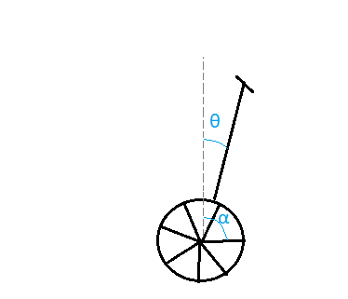
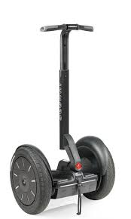
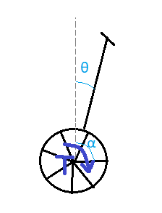
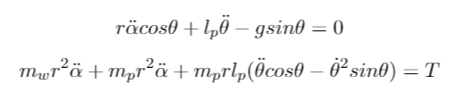
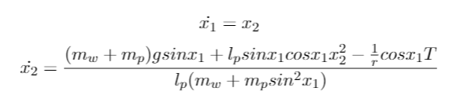
Derivation of the model
Lagrangian equation of motion

Slide 3
Stability of uncontrolled system
Two equilibria:
Θ = 0, Θ' = 0
Θ = π, Θ' = 0
Linearization around equilibria
Center

Slide 4




Sliding mode control
Change of variable
Construct sliding surface
Choose Lyapunov function

Slide 5



Stability analyzis
Continuous u
Stability condition

Slide 6
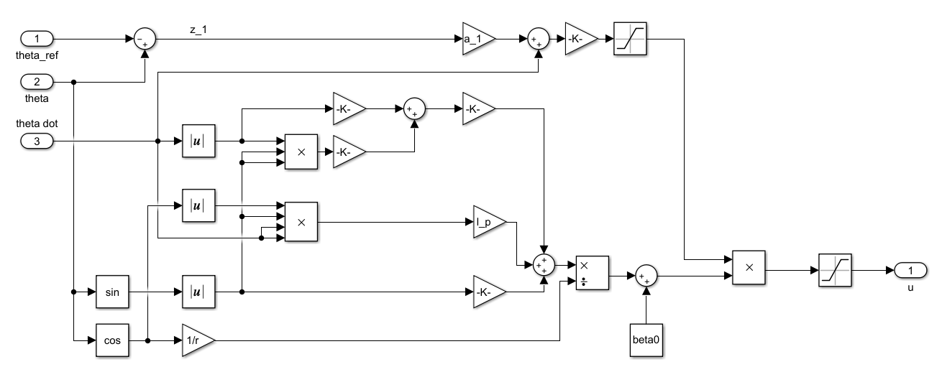

Slide 7
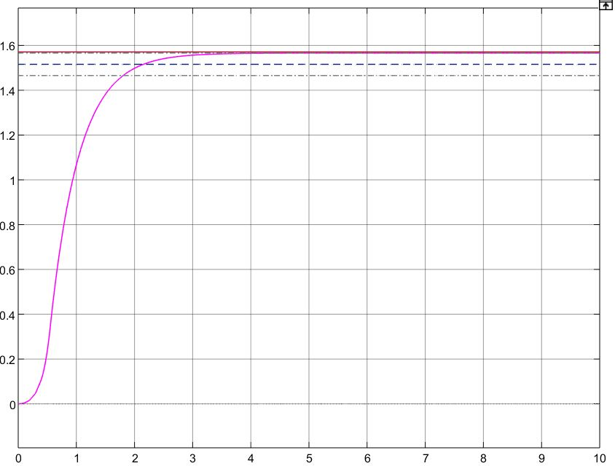
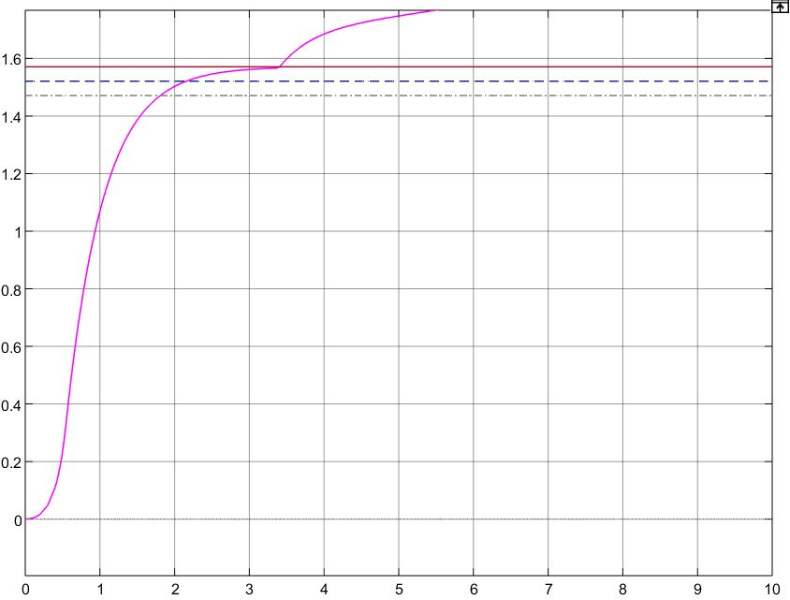
Results close to stability limit

Slide 8
Comperison with PD-controller
Stability
Referance
Initial value

Slide 9
Conclution
Stable
Doesn't reach the reference

